Slide 1





Blood Donation Management System
Presented by:
Reham lbrahim
Lana Al-Juhani
SID #4450984
SID #4451964
Atheer Al- Harbi.
Abeer Al-Anazi.
SID #4451855
SID #4453204
Tuqa Alnakhli
SID #4553366
Supervisor: Dr.Rahma Barnawi

Slide 2
Blood Donation Management System
The success of this project relies on the guidance and support of many individuals. First and foremost, we are grateful to Allah Almighty for granting us the ability to complete this endeavor. We would also like to express our sincere gratitude to our supervisor, Dr.Rahma Barnawi , who has provided invaluable direction and mentorship throughout the project's development. Additionally, we extend our appreciation to our professors and
in offering their encouragement and assistance during this journey. The
colleagues who have been instrumental
collaborative efforts of the entire team have been crucial in
shaping the project and ensuring its successful implementation.

Slide 3
Problem Definition
Millions of people require blood transfusions annually, whether due to serious injuries, major surgeries, or medical conditions like anemia, hemophilia, and sickle cell disease. However, hospitals often face difficulties in finding enough blood donors to meet this growing demand. Lack of awareness, challenges in connecting donors to recipients, and shortages of rare blood types contribute to this problem.
Blood donation is a simple yet crucial medical procedure that can directly save lives. Each whole blood donation has the potential to help up to three people in need. By donating blood, individuals can not only support critical medical treatments but also reduce their own risk of heart disease and other conditions.

Slide 4
Project Objectives
1
Enhance Visibility
Improve tracking and management of available blood supplies across hospitals and blood banks in real-time.
2
Increase Donor Engagement
Simplify the donation process and provide notifications for urgent blood needs to encourage regular donations.
3
Facilitate Efficient Matching
Ensure timely and accurate matching of donors to recipients in need of blood transfusions.
4
Raise Awareness
Educate the community on the importance of blood donation and foster a culture of regular giving.

Slide 5






Existing Blood Donation Platforms
Wateen
The official blood donation app in Saudi Arabia, aiming to reduce the communication gap between donors and blood banks, and increase awareness about the importance of voluntary blood donation.
Ihsan
Blood Bank Systems
A Saudi national platform for charitable work, including facilitating the donation process and informing users about various donation opportunities within the Kingdom.
Specialized software solutions used by hospitals and blood banks to manage the entire blood donation lifecycle, from donor registration to inventory tracking and distribution.

Slide 6

Functional Requirements
1
User Registration
Allow users to register as donors, recipients, or
administrators with secure accounts and profiles.
2
Donor Search
Enable recipients to search for compatible blood donors
based on criteria like blood type, location, and availability.
3
Appointment Scheduling
Facilitate the process of scheduling blood donation appointments between donors and recipients.

Slide 7
Non-Functional Requirements
1
1. Usability: Ensure the website is user-friendly and accessible to
all users, including those with disabilities.
2. Performance: Ensure the system can handle multiple
2
concurrent users and maintain responsiveness during peak usage times.
3. Security: Implement measures to protect user data, including
encryption of sensitive information and secure login mechanisms.
4. Reliability: Ensure the system is reliable and available 24/7, with minimal downtime for maintenance or upgrades.
3

Slide 8
Database & Languages Used
Languages:
Database: MySQL for secure data storage. Stores donor details, recipient requests, appointment schedules, and blood inventory.
1
HTML & CSS: For designing the interface.
2
PHP: For server-side logic
3
JavaScript: For interactive features

Slide 9


Use Case Diagram
User Interface
The web-based user interface provides a seamless and intuitive experience for donors, recipients, and administrators to interact with the system.
Application Logic
The application layer handles the core functionalities, such as user management, appointment scheduling, and inventory tracking, ensuring the system's overall functionality.
Database
The database component securely stores and manages all the relevant data, including donor profiles, blood inventory, and donation records.

Slide 10
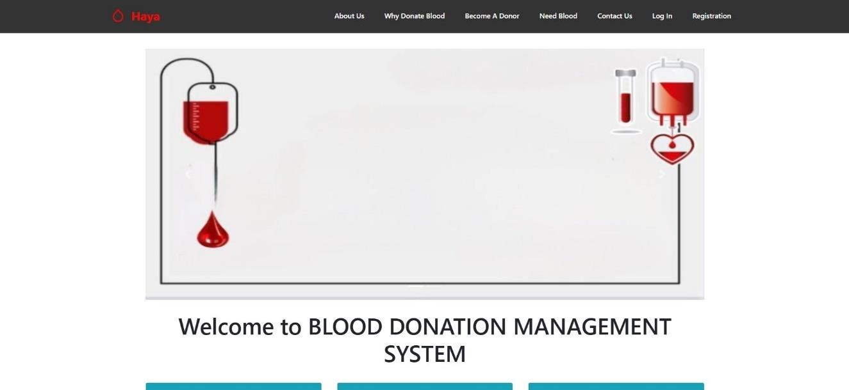
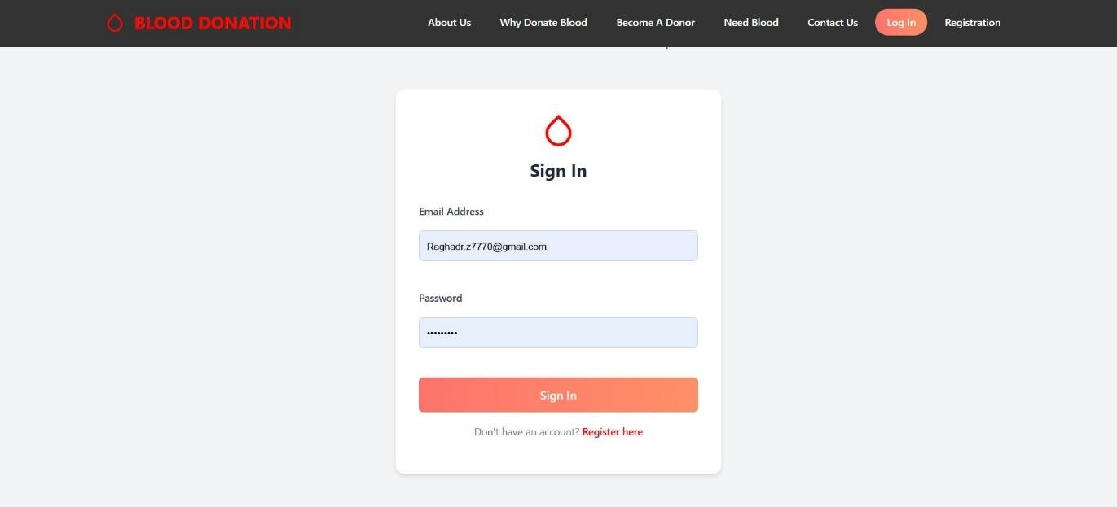
User Interface Design
Home page user interface design
User interface design of LOGIN

Slide 11
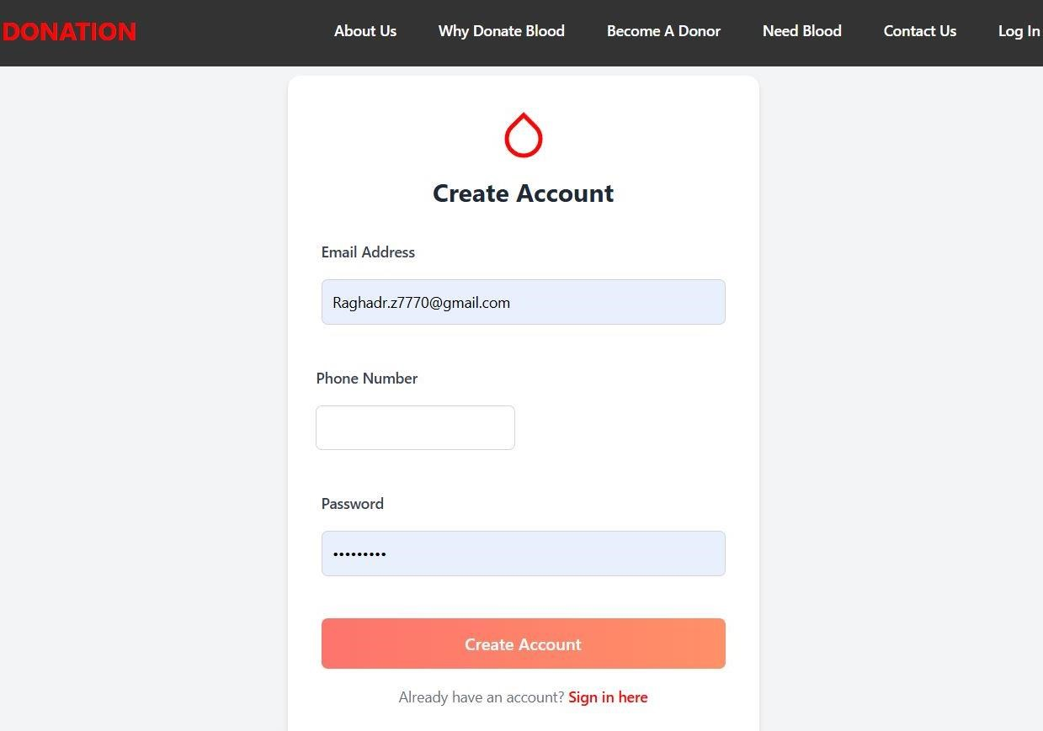
User interface design of CREATE AN ACCOUNT

Slide 12
Tools & Technologies
Languages: HTML, CSS, PHP, JavaScript. Database: MySQL. Testing Tools: Online Domin.

Slide 13
Challenges & Future Work
Challenges: Limited mobile access, no advanced analytics. Future Work: Develop a mobile app. Add real-time hospital system integration. Introduce analytics for better forecasting.

Slide 14
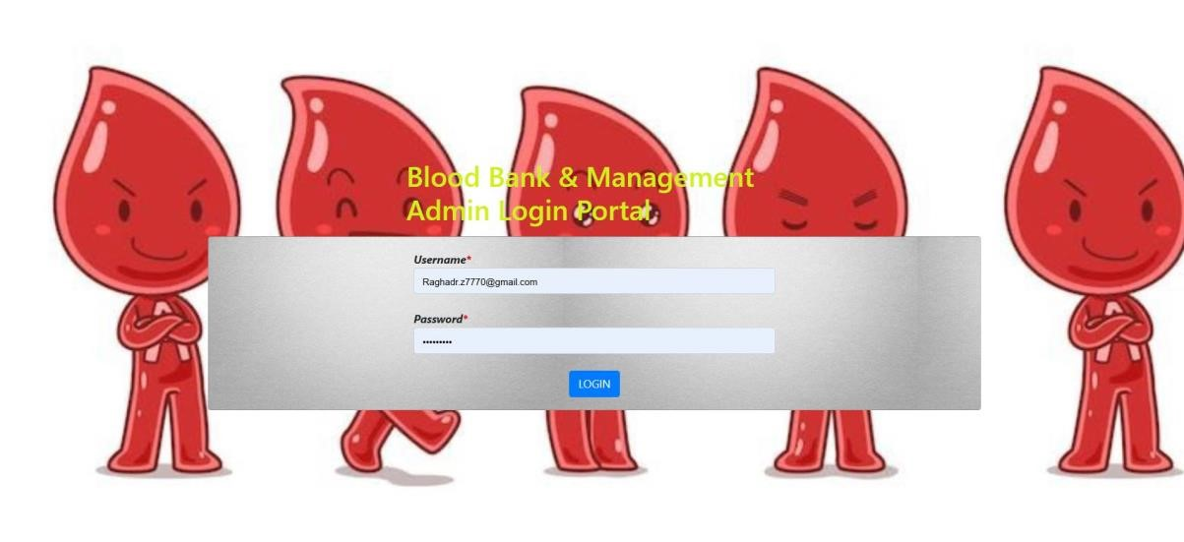
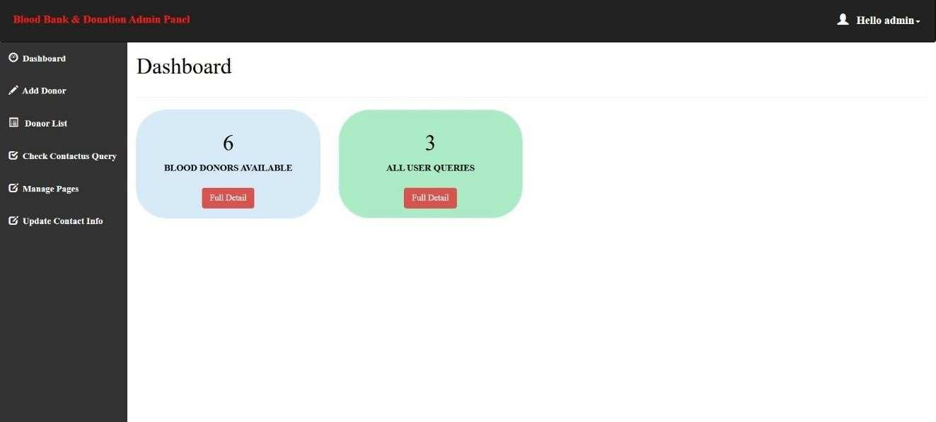
Admin Log In
Admin Dashboard

Slide 15
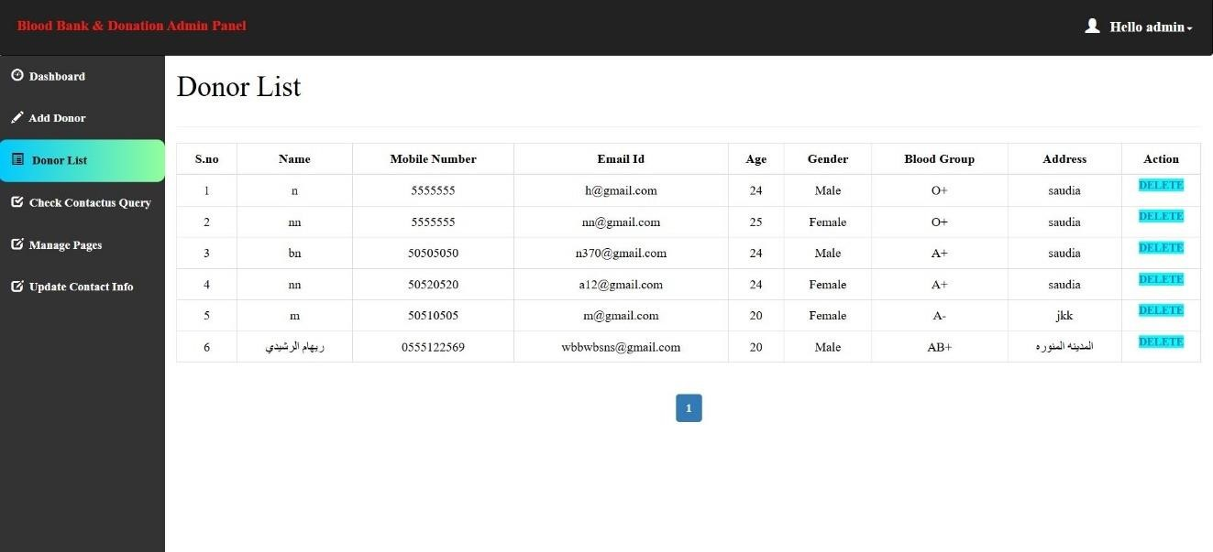
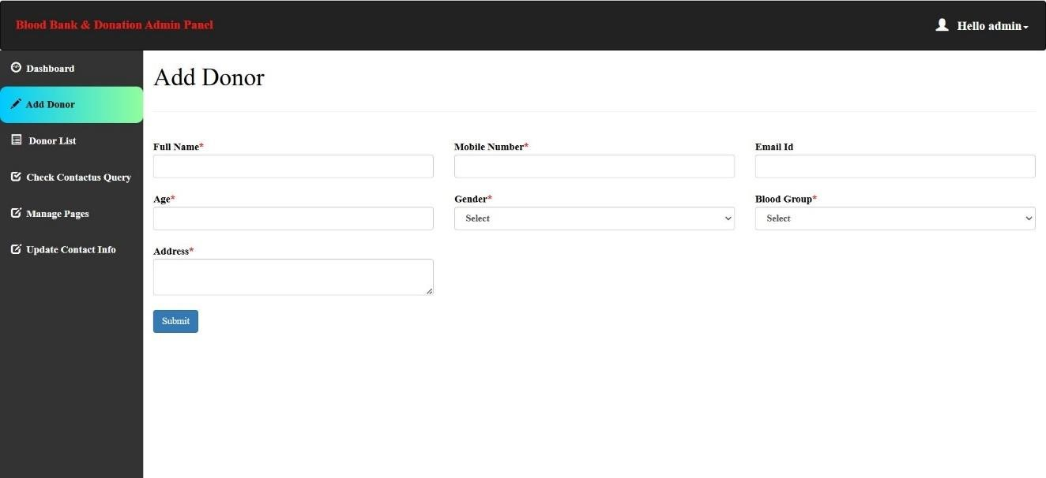
Admin Donor List
Add Donor

Slide 16
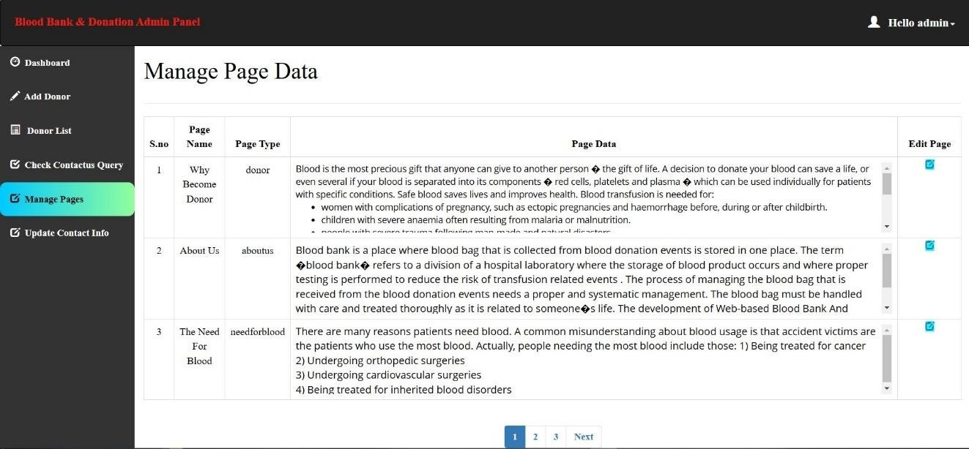
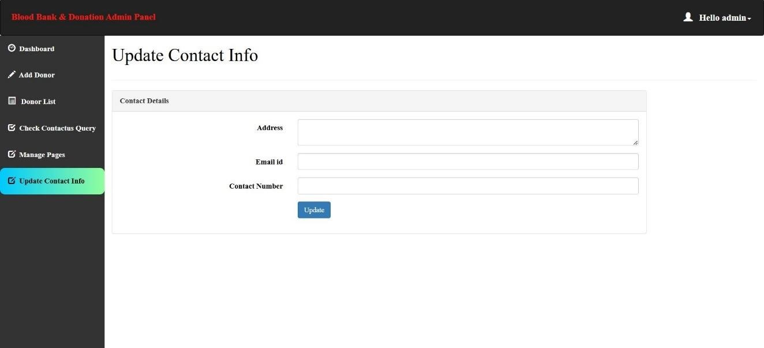
Admin Manage Page Data
Admin Update Contact Info

Slide 17
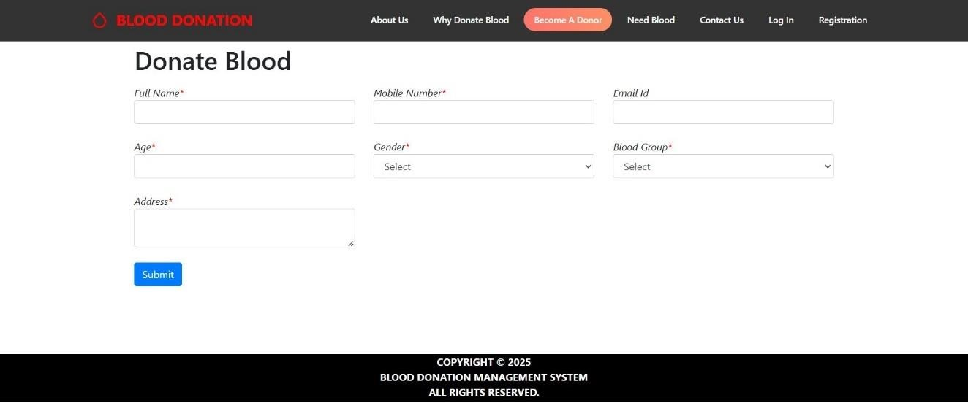
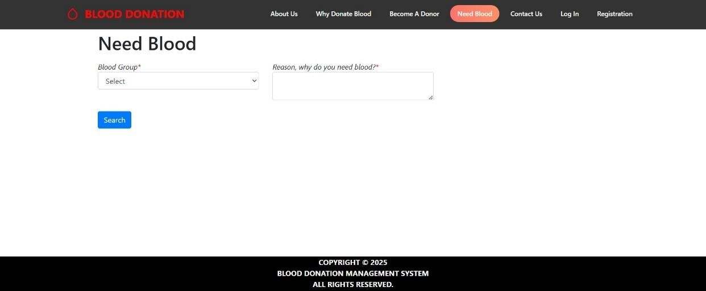
User Donate Blood
User Need Blood

Slide 18
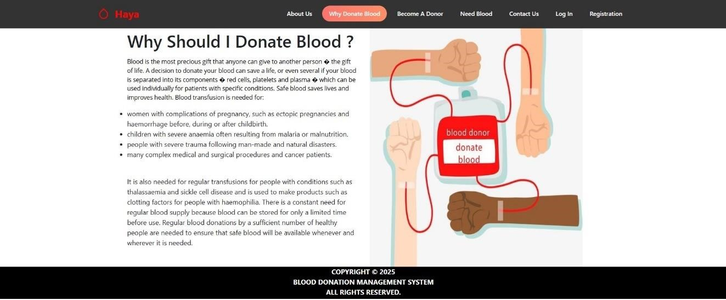
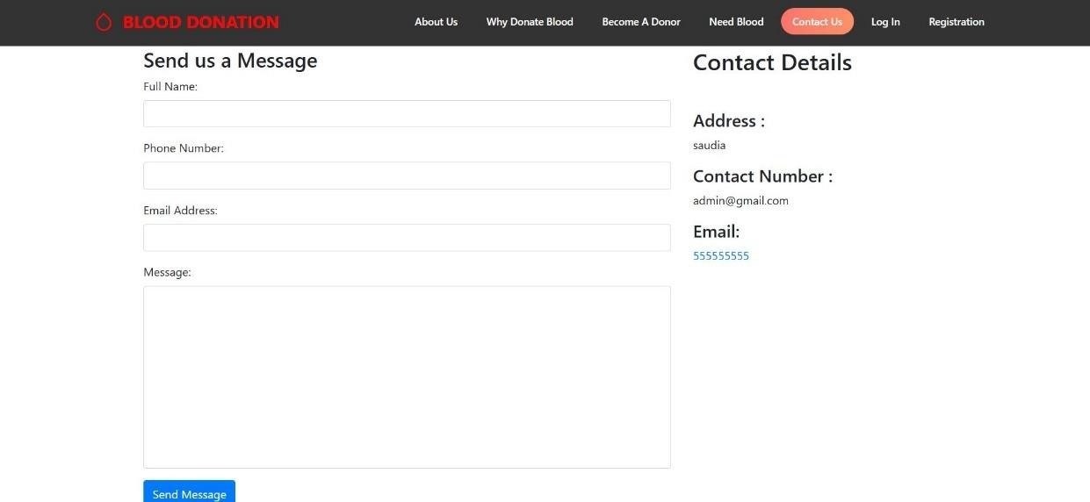
User Why Should I Donate Blood
User Contact Us

Slide 19

Conclusion
The Blood Donation Management System project represents a comprehensive and strategic approach to addressing the critical issue of blood shortages in our community. By leveraging technology, streamlining processes, and fostering a culture of donation, this platform aims to save lives and have a lasting positive impact on public health.
Through the implementation of this system, we envision a
future where blood donation is a seamless, accessible, and widely-embraced practice, ensuring that those in need of
life-saving transfusions can receive the support they require. The project's success will be measured not only by its technical capabilities but also by its ability to inspire and empower individuals to become active contributors to this vital cause.

